Slide 1
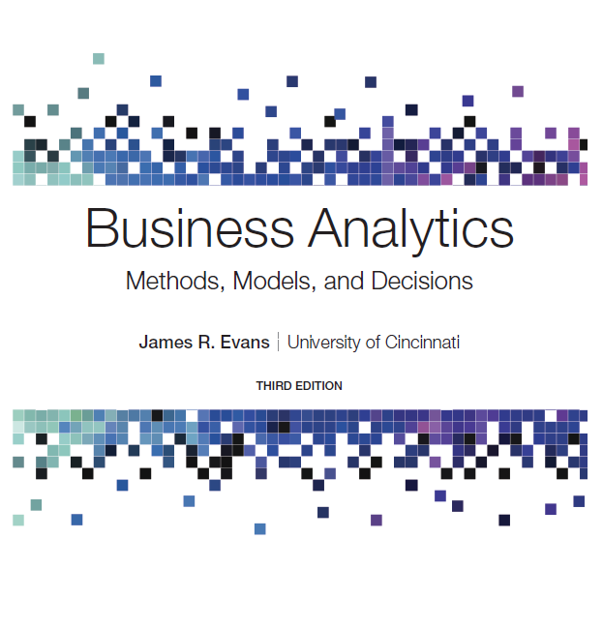
Business Analytics: Methods, Models, and Decisions
Third Edition
Chapter 2
Database Analytics
Copyright © 2020, 2016, 2013 Pearson Education, Inc. All Rights Reserved
Notes:
If this PowerPoint presentation contains mathematical equations, you may need to check that your computer has the following installed:
1) MathType Plugin
2) Math Player (free versions available)
3) NVDA Reader (free versions available)

Slide 2
Data Sets and Databases
Data set - a collection of data
Examples: Marketing survey responses, a table of historical stock prices, and a collection of measurements of dimensions of a manufactured item
Database - a collection of related files containing records on people, places, or things
A database file is usually organized in a two-dimensional table, where the columns correspond to each individual element of data (called fields, or attributes), and the rows represent records of related data elements.

Slide 3
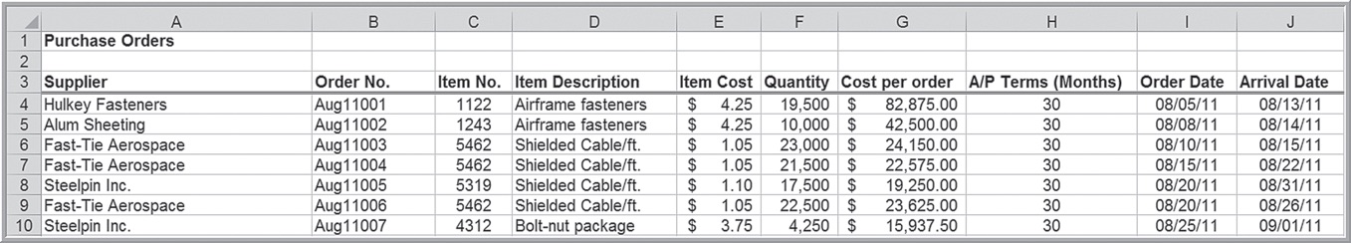
Example 2.1: A Purchase Order Database
Each row represents a record.
Each column represents a field or attribute.

Slide 4
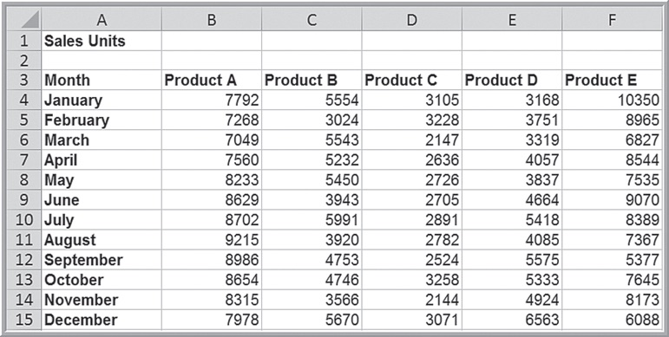



Example 2.2: Using Range Names for a Database
Define the range name for each row of data as the month, and the name for each column of data by the product.
Example: The range name for
is January; the range
name for
To find the annual sales of Product A, use the Excel

Slide 5
Data Queries: Tables
An Excel table allows you to use table references to perform basic calculations. Select the data range including headers. Next, click Table from the Tables group on the Insert tab and make sure that the box for My Table Has Headers is checked.
The table name (default: Table1),can be found (and changed) in the Properties group of the Table Tools Design tab in Windows or in the Table tab on a Mac.

Slide 6
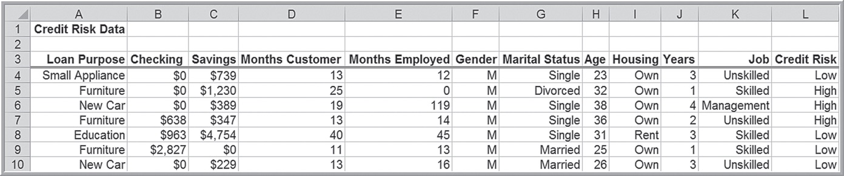
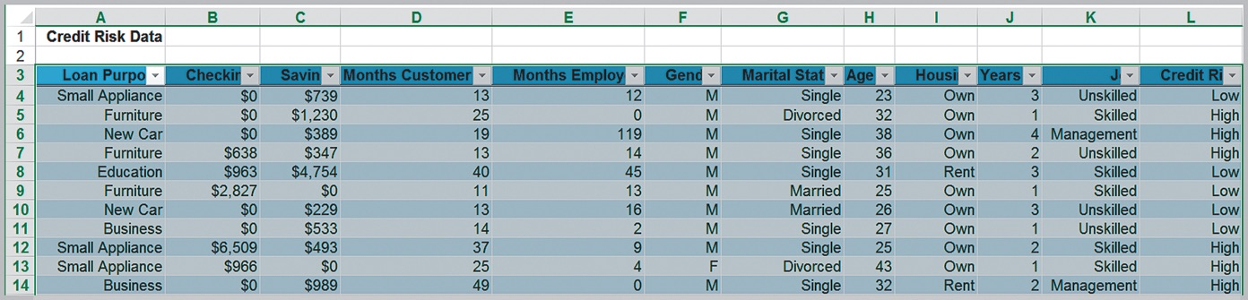
Example 2.3: Excel Table for Credit Risk Data

Slide 7
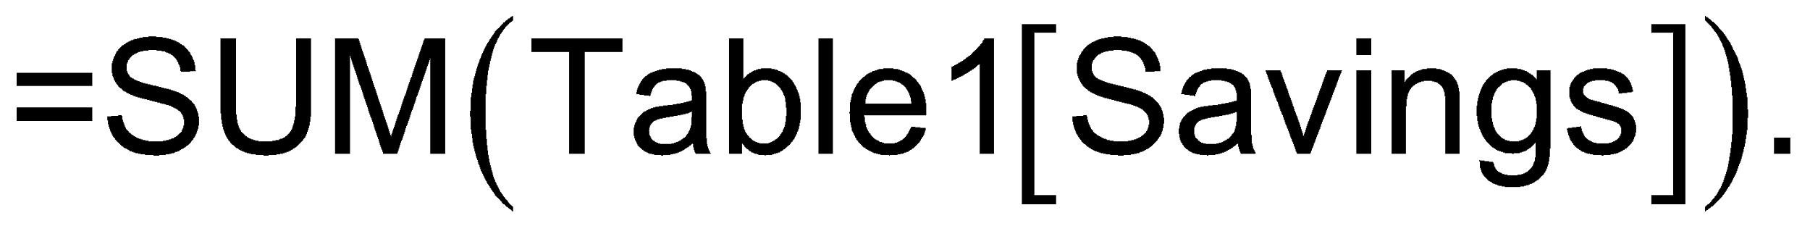
Example 2.4: Table-Based Calculations
To sum the data in column C, use the function
To find the number of home owners use the function
If we add new records to the table, the calculation will be updated automatically.

Slide 8

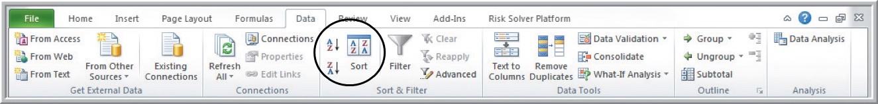
Data Queries: Sorting Data
Select a cell (but not the header) in the column for sorting.
Use the
buttons on the Data tab to
sort from low to high or high to low.
Click the Sort button for advanced sorting.

Slide 9
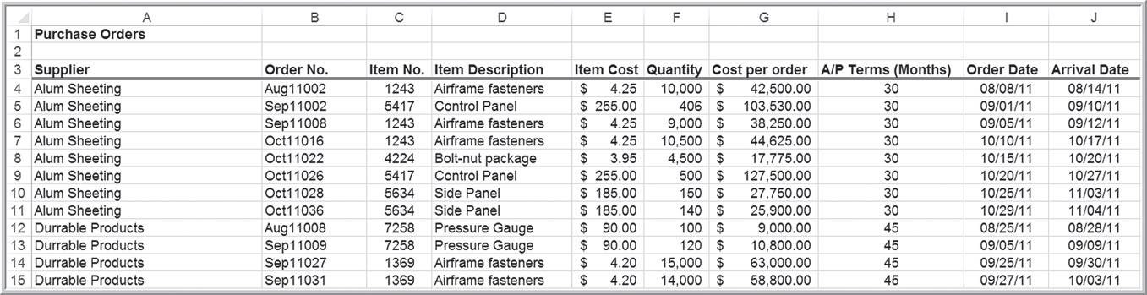
Example 2.5: Sorting Data in the Purchase Orders Database
Sort data by supplier.

Slide 10
Pareto Analysis
An Italian economist, Vilfredo Pareto, observed in 1906 that a large proportion of the wealth in Italy was owned by a small proportion of the people.
Similarly, businesses often find that a large proportion of sales come from a small proportion of customers, the “80-20 rule.”
A Pareto analysis involves sorting data and calculating cumulative proportions.

Slide 11
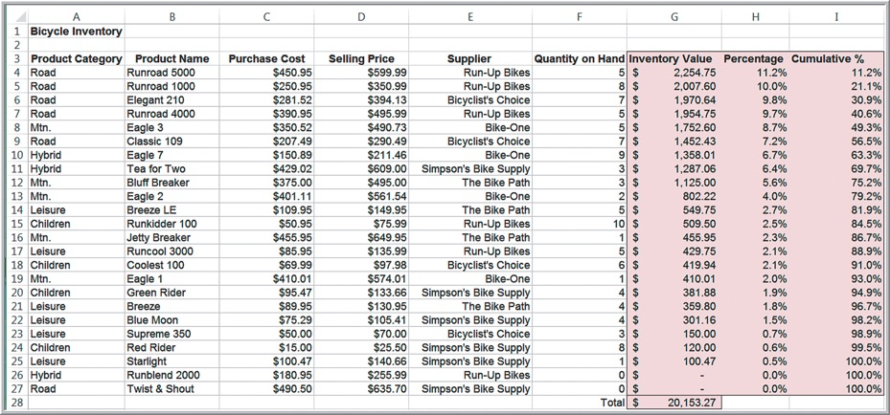
Example 2.6: Applying the Pareto Principle
In the Bicycle Inventory database, compute the inventory value of each product by multiplying the quantity on hand by the purchase cost. Sort the data in decreasing order of inventory value and compute the percentage of the total inventory value for each product and the cumulative percentage.

Slide 12
Data Queries: Filtering Data
Filtering is finding a subset of records that meet certain characteristics.
Excel provides two filtering tools:
AutoFilter for simple criteria
Advanced Filter for more complex criteria.

Slide 13
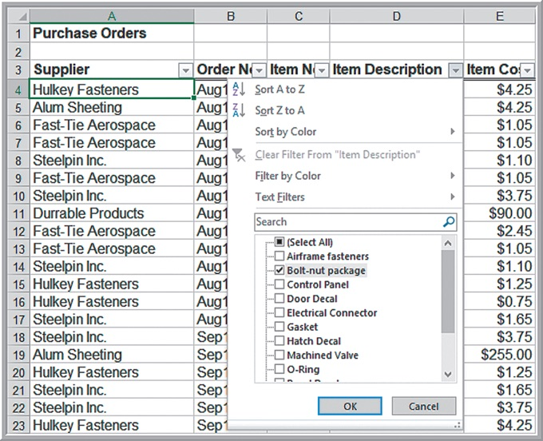
Example 2.7: Filtering Purchase Order Records by Item Description (1 of 2)
First, select any cell within the database. Then, from the Data tab, click Filter. Click on cell D3 dropdown arrow. Select only Bolt-nut package.

Slide 14
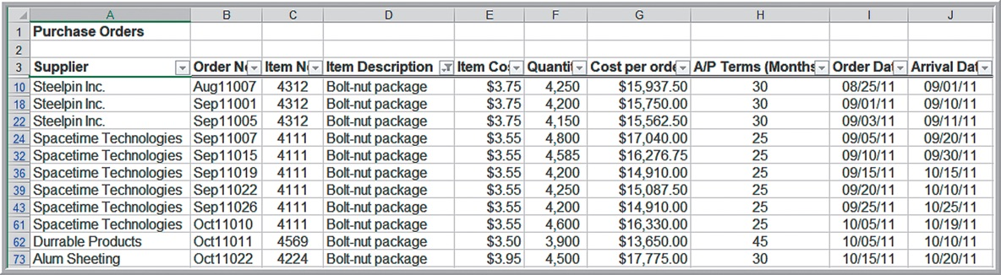
Example 2.7: Filtering Purchase Order Records by Item Description (2 of 2)
The Filter tool will display only those orders for this item.
To restore the original data file, click on the drop-down arrow again and then click Clear filter from “Item Description.”

Slide 15
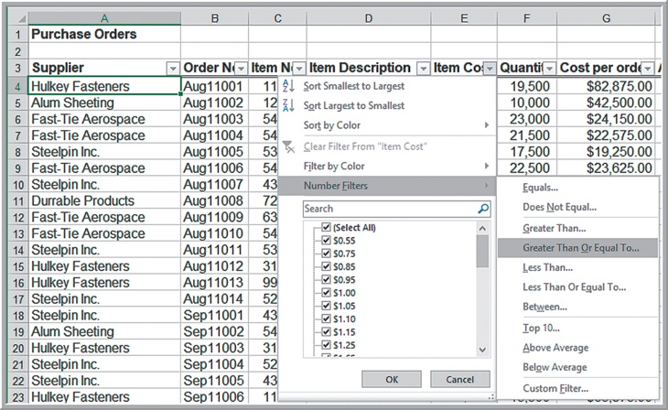

Example 2.8: Filtering Records by Item Cost (1 of 2)
Identify all records in the Purchase Orders database whose item cost is at least $200.
Click on the drop-down arrow in the Item Cost column and position the cursor over Numbers Filter. Select Greater

Slide 16
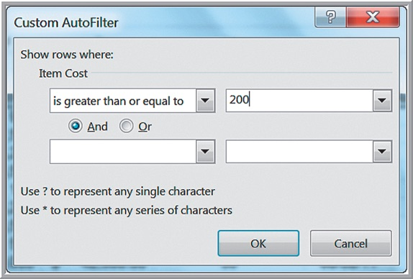
Example 2.8: Filtering Records by Item Cost (2 of 2)
This brings up a Custom AutoFilter dialog that allows you to specify up to two specific criteria using “and” and “or” logic. (The Mac version does not have these and/or options.) Enter 200 in the box and then click Ok.

Slide 17
Caution!
The Filter tool does not extract the records; it simply hides the records that don’t match the criteria.
This means that if you highlight a range of filtered data to compute a sum or average, for example, you will get the results for all records, including those that are hidden from view.
You can copy and paste the filtered data to another range or Excel worksheet, which then uses only the filtered records, and get the correct results.

Slide 18
Advanced Filter
The Advanced Filter provides a way of explicitly defining criteria by which to filter a database.
First, copy the headers from the database to an open location in the worksheet. Under the headers, specify the criteria that you want to use to filter the data.
Multiple criteria in the same row are logically joined by “and,” while criteria in rows are joined by “or.”

Slide 19
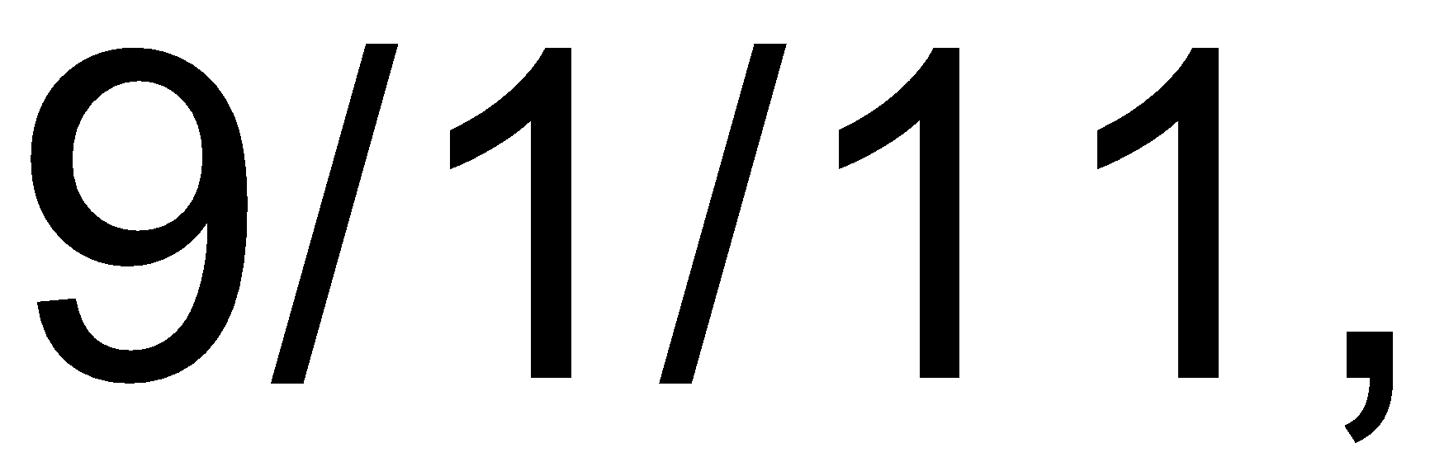

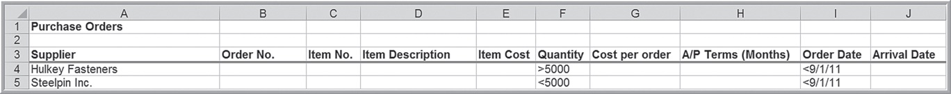
Example 2.9: Using the Advanced Filter (1 of 3)
For the Purchase Orders database, we will find all the records for Hulkey Fasteners having order quantities that exceed 5,000 and order dates
before
as well as all records for Steelpin
Inc. with order quantities less than 5,000 and
order dates before

Slide 20
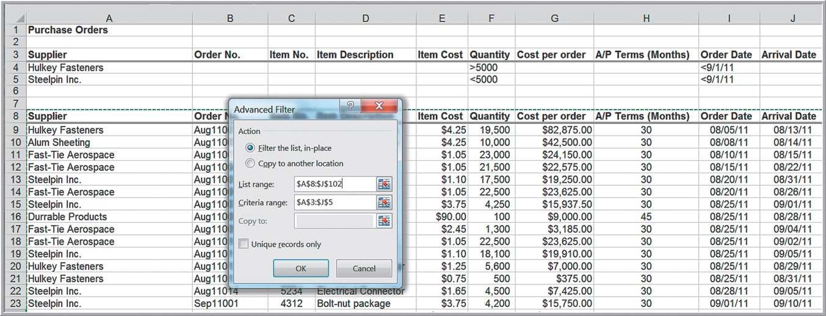
Example 2.9: Using the Advanced Filter (2 of 3)
Choose Advanced next to the Filter in the Data tab. In the dialog box, enter the list range of the database and the criteria range.

Slide 21
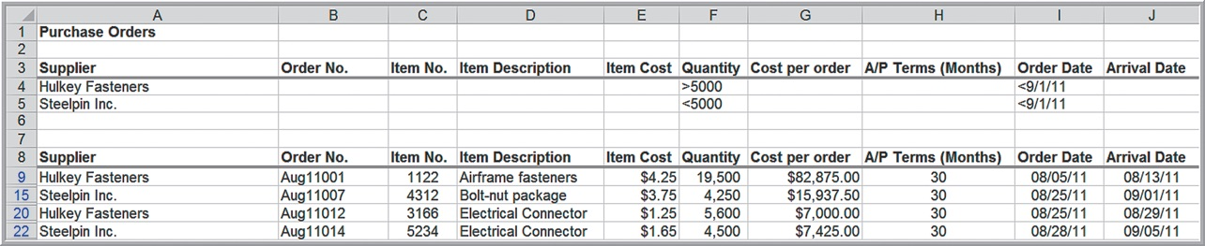
Example 2.9: Using the Advanced Filter (3 of 3)
Results
Note that only the records meeting the criteria are displayed.

Slide 22
Database Functions
Database functions start with a “D” (for example, D SUM, D AVERAGE, D COUNT) and allow you to specify criteria that limit the calculations to a subset of records using the same format as the Advanced Filter.
For example, the syntax for the D SUM function is
Database is the range
that includes the column labels; field is the column name that contains the values to sum, enclosed in quotation marks, or a reference to the column name; and criteria is the range that specifies the records you want to sum.

Slide 23
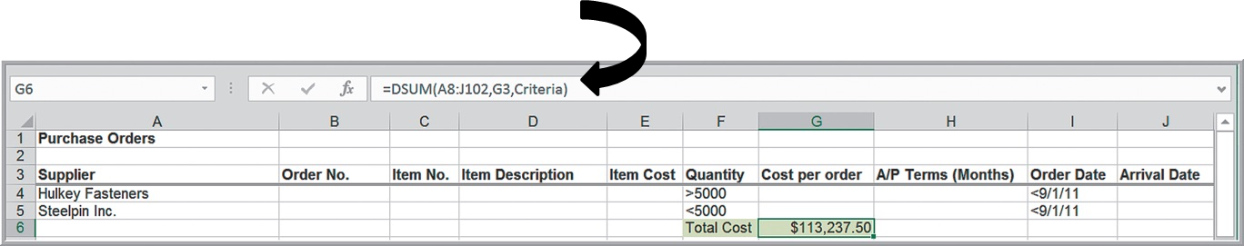
Example 2.10: Using a Database Function
In the Purchase Orders database, find the total cost of all orders that meet the criteria specified in Example 2.9:
Alternatively, we could have used the function

Slide 24
Logical Functions
- returns
one value if the condition is true and another if the condition is false,
- returns TRUE
if all conditions are true and FALSE if not,
- returns TRUE if
any condition is true and FALSE if not.

Slide 25






IF Function
Conditions may include the following:
equal
not equal to
greater than
greater than or equal to
less than
less than or equal to

Slide 26
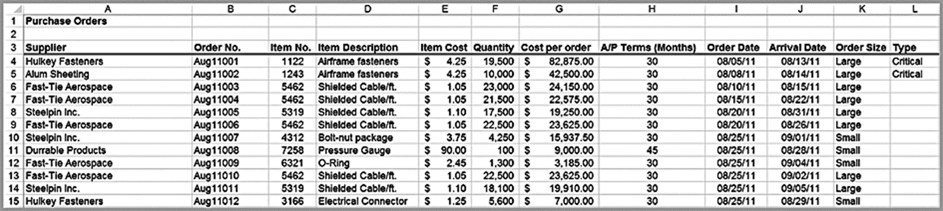
Example 2.11: Using the IF Function
Suppose that orders with quantities of at least 10,000 units are classified as Large.
Suppose that large orders with a total cost of at least $25,000 are considered critical.

Slide 27
Nesting IF Functions
You may “nest” up to seven IF functions by replacing value if true or value if false in an IF function with another IF function:

Slide 28
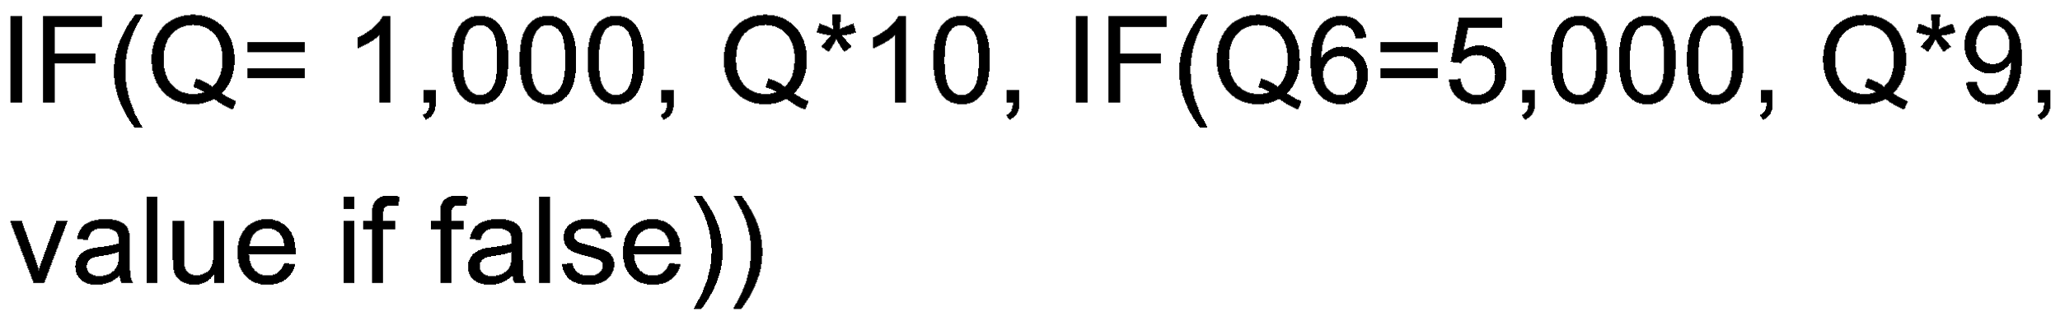
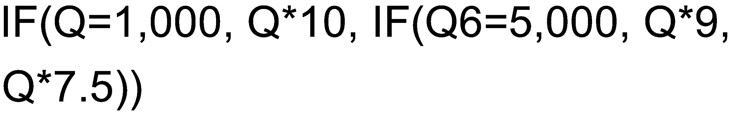
Example 2.12: Calculating the Price of Quantity Discounts
For quantities of 1,000 or less, the unit price is $10; for quantities of 1,001 to 5,000, the unit price is $9.00; and for quantities that exceed 5,000, the unit price is $7.50.

Slide 29

Lookup Functions for Database Queries
- looks up a value in the leftmost column of a table and returns a value in the same row from a column you specify
- looks up a value in the top row of a table and returns a value in the same column from a row you specify.
- returns a value or reference of the
cell at the intersection of a particular row and column in a given range.
- returns the relative
position of an item in an array that matches a specified value in a specified order.
- returns a value from
a list based on the position in the list, specified by

Slide 30



Important Notes on Lookup Functions
In the V LOOKUP and H LOOKUP functions, range lookup is optional. If this is omitted or set as True, then the first column of the table must be sorted in ascending numerical order.
If an exact match for the
is found in the first
column, then Excel will return the value of
of that row. If an exact match is not found, Excel will choose the row with the largest value in the first column that is less than the
If range lookup is False, then Excel seeks an exact match in the first column of the table range. If no exact match is found, Excel

Slide 31
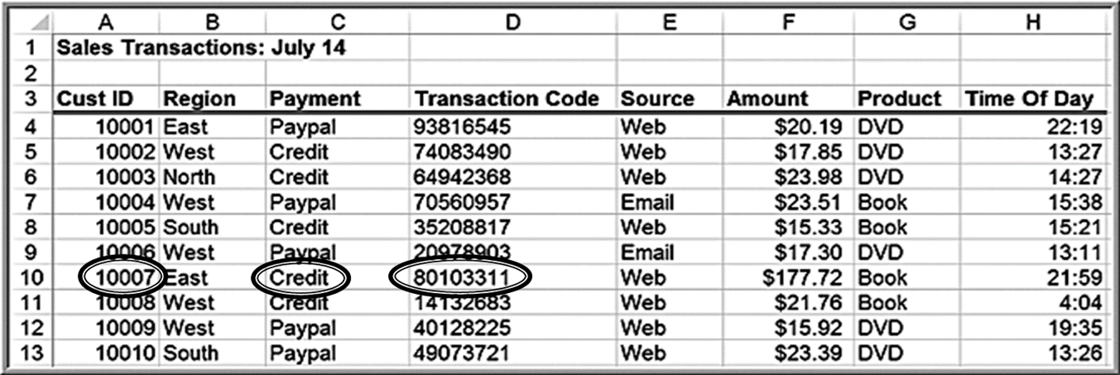
Example 2.13: Using the V LOOK UP Function
returns the payment type Credit.
returns the transaction code
80103311

Slide 32
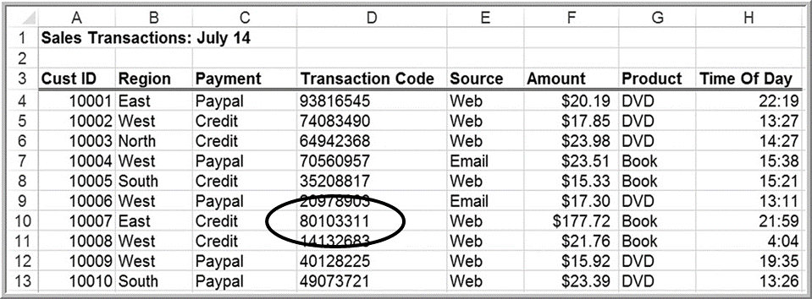
INDEX Function
The INDEX function returns the value in a particular row and column of an array.
would retrieve the transaction
code 80103311, which is in the 7th row and 4th column of the database.

Slide 33



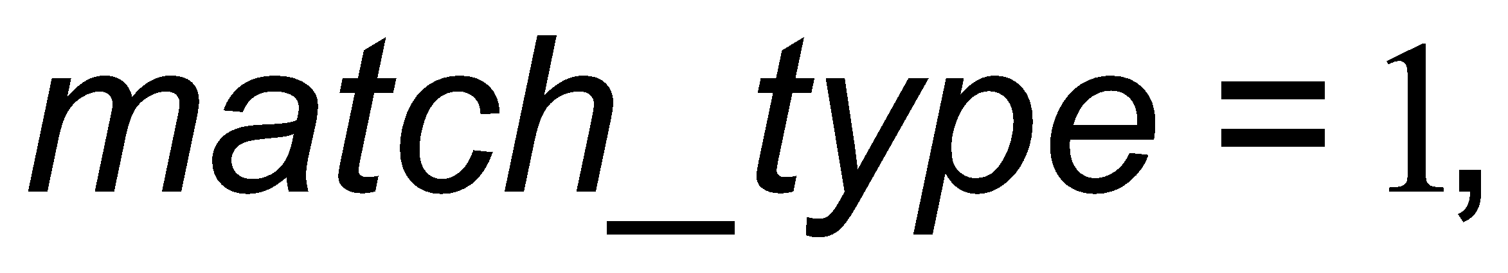


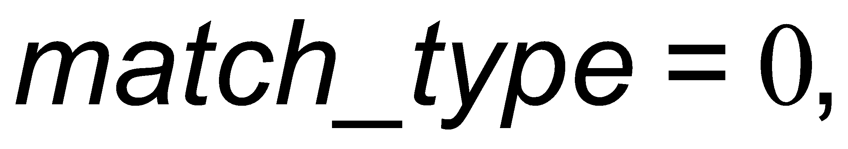
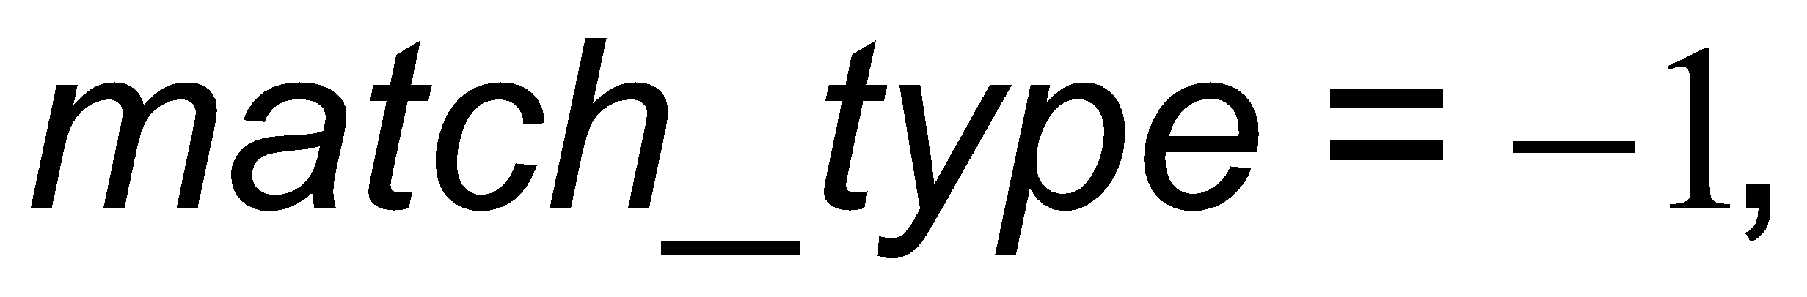

MATCH Function
In the MATCH function,
is value that you want to
match in
which is the range of cells being searched.
is either −1, 0, or 1. The default is 1.
If
then the function finds the largest value that is
less than or equal to
The values in the
must be placed in ascending order
If
MATCH finds the first value that is exactly equal to
The values in the
can be in any order.
If
then the function finds the smallest value that is
greater than or equal to
The values in the
must be placed in descending order.

Slide 34
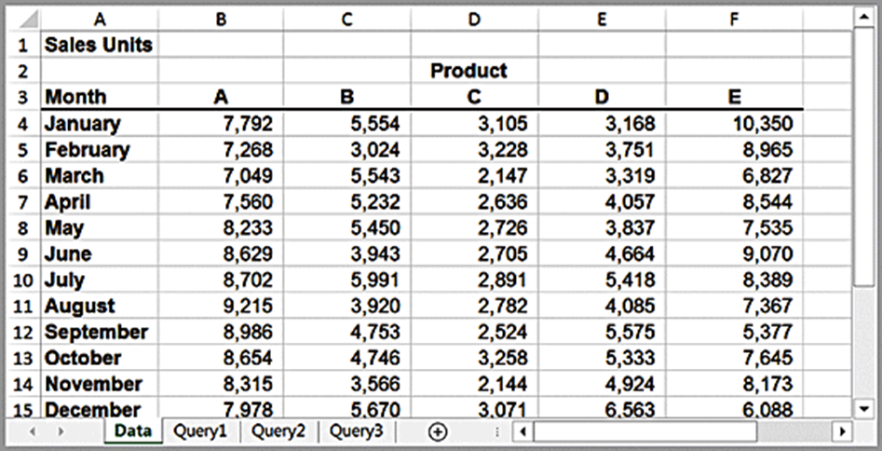
Example 2.14: Using INDEX and MATCH Functions for Database Queries
Suppose we wish to design a simple query application to input the month and product name, and retrieve the corresponding sales. The three additional worksheets in the workbook show how to do this in three different ways.

Slide 35
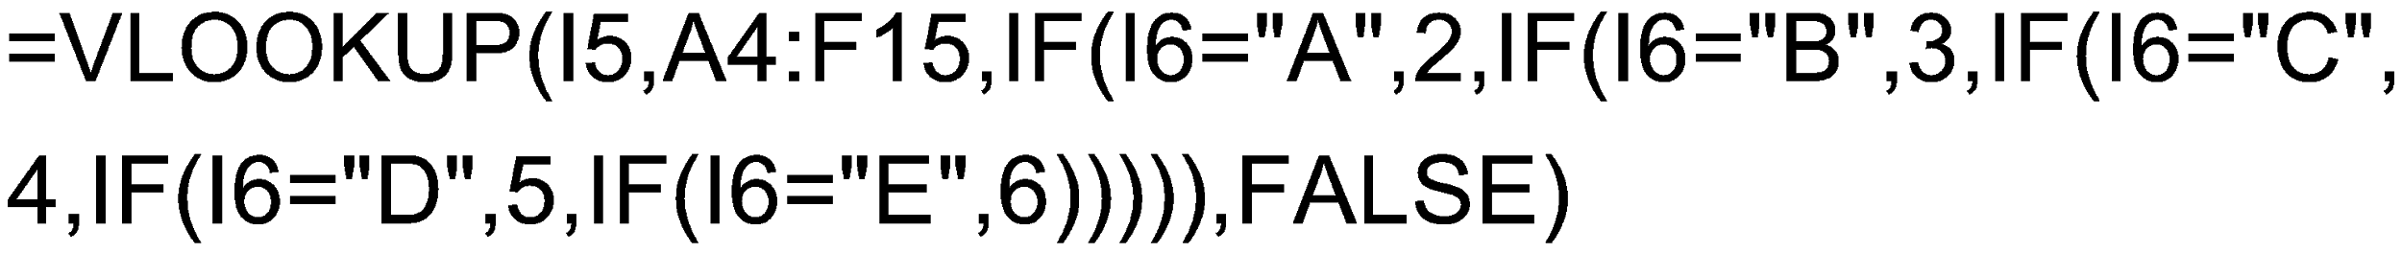
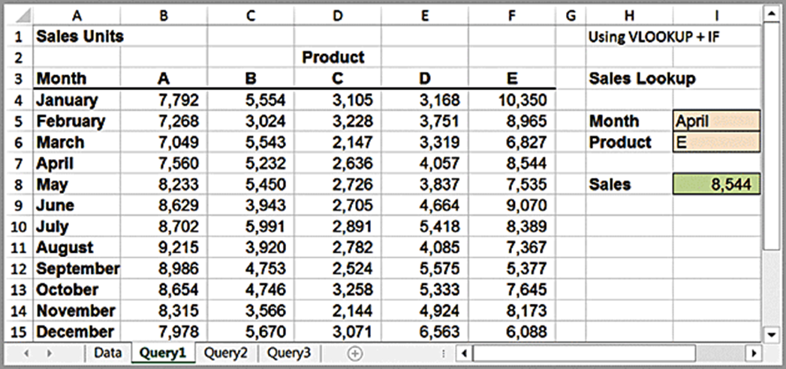
Example 2.14 Continued: Using V LOOK UP + If
The Query1 worksheet uses the V LOOK UP function with embedded IF statements. The formulas in cell I8 is:

Slide 36
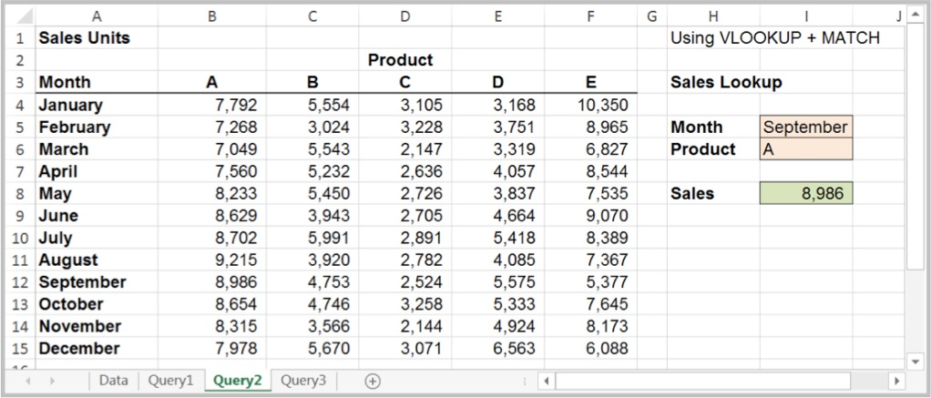
Example 2.14 Continued: Using V LOOK UP + MATCH
The formula in cell I8 is:
= VLOOKUP (I5,A4:F15,MATCH(I6,B3:F3,0) + 1,FALSE)
In this case, the MATCH function is used to identify the column in the table corresponding to the product name in cell I6. Note the use of the “+1” to shift the relative column number of the product to the correct column number in the lookup table.

Slide 37
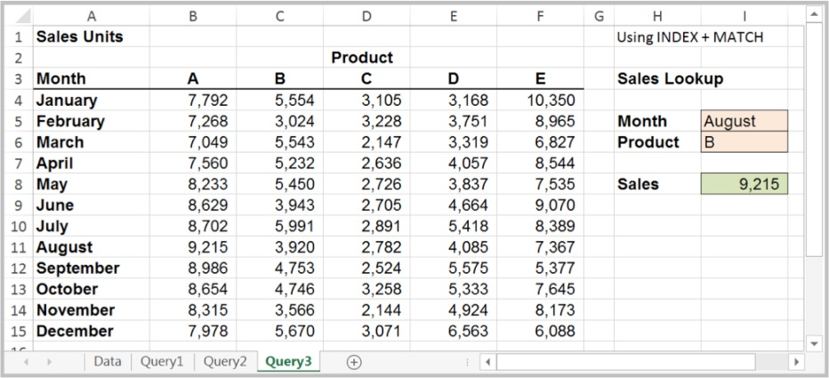
Example 2.14 Continued: Using INDEX + MATCH
The formula in cell I8 is:
= INDEX(A4:F15,MATCH(I5,A4:A15,0),MATCH(I6,A3:F3,0))
The MATCH functions are used as arguments in the INDEX function to identify the row and column numbers in the table based on the month and product name. The INDEX function then retrieves the value in the corresponding row and column.

Slide 38
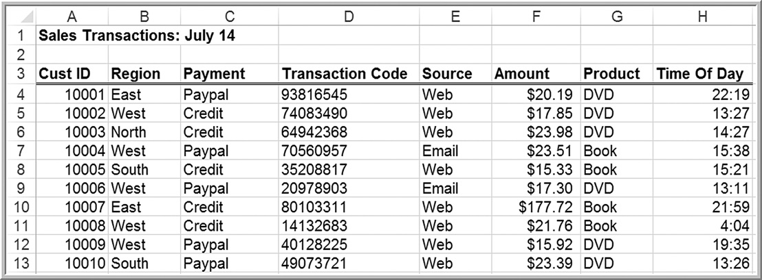
Example 2.15: Using INDEX and MATCH for a Left Table Lookup (1 of 2)
In the Sales Transactions database, we wish to find the customer ID associated with a specific transaction code.

Slide 39

Example 2.15: Using INDEX and MATCH for a Left Table Lookup (2 of 2)
Enter the transaction code in cell K2, and display the customer ID in cell K4.
Use the following formula in cell K4:

Slide 40
Excel Template Design
User-friendly templates for repetitive database queries.
Characteristics:
”Clean”
Well-organized
Easy to use

Slide 41
Example 2.16: A Tax Bracket Calculator
2016 U.S. federal income tax rates
1. Single | 2. Married filing jointly or qualifying window/windower | 3. Married filing separately | 4. Head of household | Tax rate
Up to $9,275 | Up to 18,550 | Up to $9,275 | Up to $13,250 | 10%
$9,276 to $37,650 | $18,551 to $75,300 | $9,276 to $37,650 | $13,251 to $50,400 | 15%
$37,651 to $91,150 | $75,301 to $151,900 | $37,651 to $75,950 | $50,401 to $130,150 | 25%
$91,151 to $190,150 | $151,901 to $231,450 | $75,951 to $115,725 | $130,151 to $210,800 | 28%
$190,151 to $413,350 | $231,451 to $413,350 | $115,726 to $206,675 | $210,801 to $413,350 | 33%
$413,351 to $415,050 | $413,351 to $466,950 | $206,676 to $233,475 | $413,351 to $441,000 | 35%
$415,051 or more | $466,951 or more | $233,476 or more | $441,001 or more | 39.60%
Create a template that allows an individual to enter their filing status and taxable income and then returns the corresponding tax bracket.

Slide 42
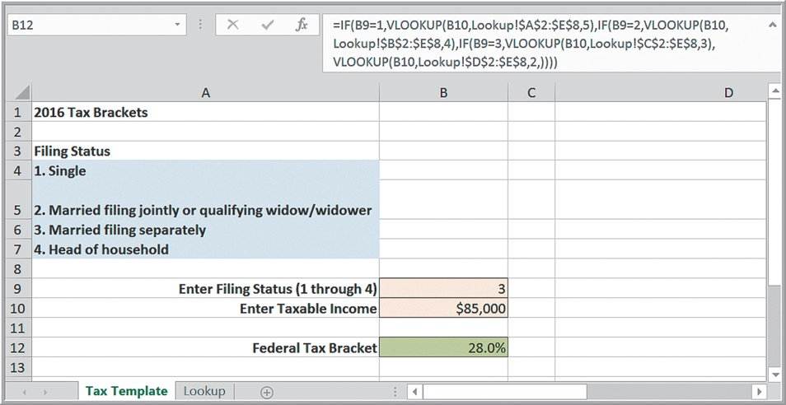
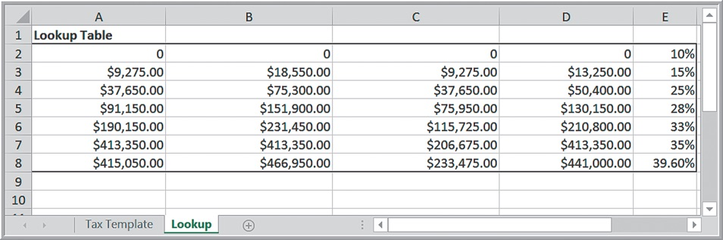
Example 2.16 Continued: Using IF and V LOOK UP

Slide 43
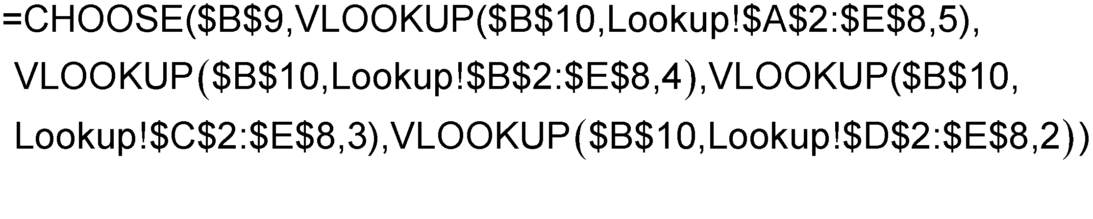
Example 2.16 Continued: Using CHOOSE

Slide 44
Data Validation Tools
Select the cell range for which data validation will be applied, and then choose Data Validation from the Data Tools group on the Data tab in Excel 2016, or select Validation from the Data menu on the a Mac.

Slide 45
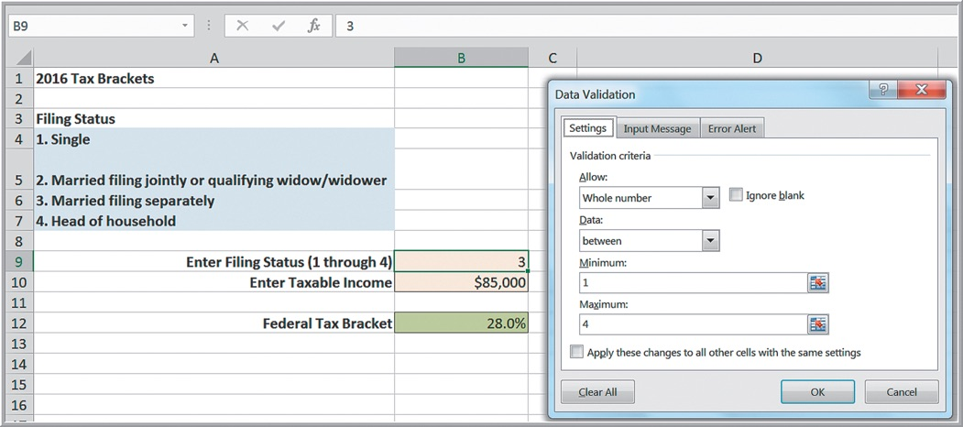
Example 2.17: Applying Data Validation
For the Tax Bracket template, choose cell B9 (filing status). In the Data Validation dialog, specify that the value must be a whole number between 1 and 4. You may customize the Error Alert and Input Message to prompt the user.

Slide 46
ISNUMBER Function
This function returns TRUE if the cell or range contains a number; otherwise, it returns FALSE.

Slide 47
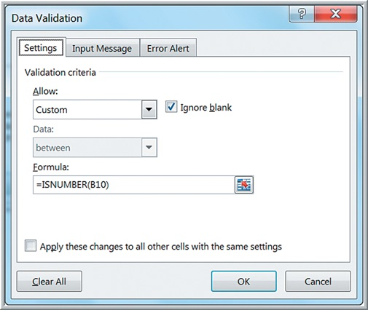
Example 2.18: Using the ISNUMBER Function for Data Validation
In the Tax template, use ISNUMBER to ensure that the taxable income in cell B10 is numeric. In the Data Validation dialog, choose Custom, and in the Formula
box, enter the
An error alert
message will pop up if an invalid entry is made.

Slide 48
Form Controls (1 of 2)
Buttons, boxes, and other mechanisms for inputting or changing data on spreadsheets easily that can be used to design user-friendly spreadsheets.
Spin button-a button used to increase or decrease a numerical value
Scroll bar-a slider used to change a numerical value
Check box-a box used to select or deselect a scenario
Option button-a radio button used to select an option
List box-a box that provides a list of options
Combo box-a box that provides an expandable list of options
Group box-a box that can hold a group of controls

Slide 49
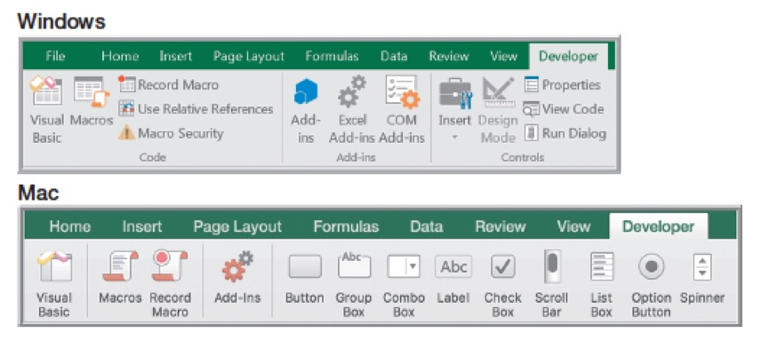
Form Controls (2 of 2)
Activate the Developer tab on the Excel Ribbon.

Slide 50
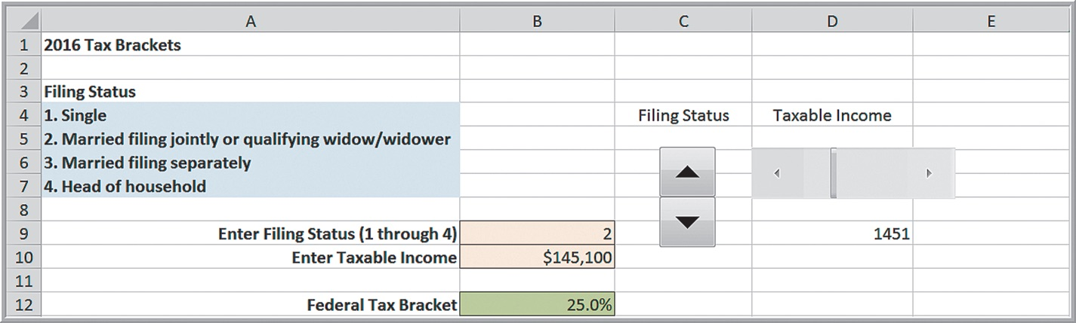
Example 2.19: Using Form Controls in the Tax Bracket Template
Insert the form control (spin button for filing status, and scroll bar for taxable income).
Right click and complete the Format Control dialog.

Slide 51
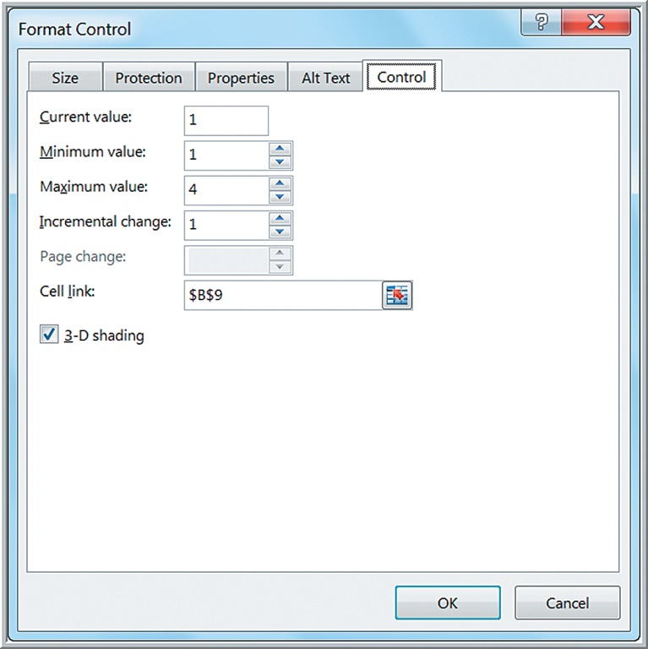
Format Control Dialog for Spin Button

Slide 52
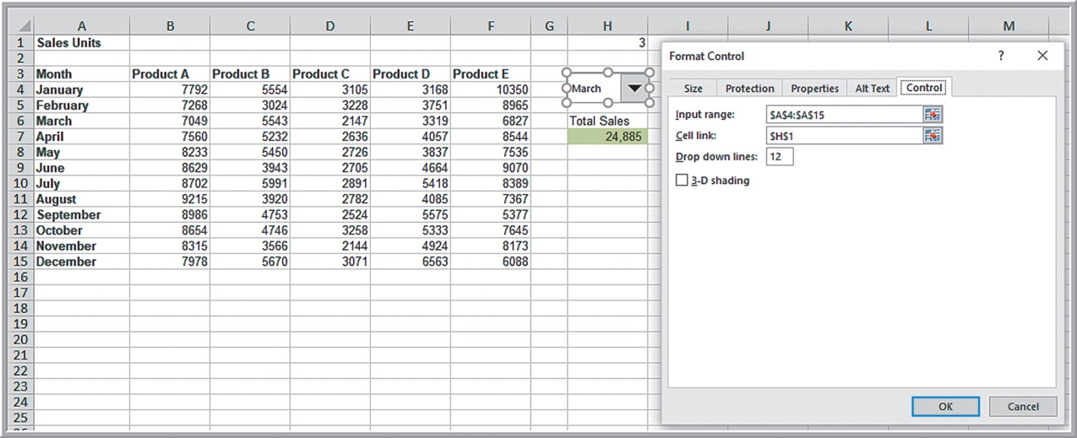
Example 2.20: Using a Combo Box
Compute the total sales for any month in the Monthly Product Sales database.

Slide 53
Exploring Data Using PivotTables
Excel provides a powerful tool for distilling a complex data set into meaningful information: PivotTables.
PivotTables allows you to create custom summaries and charts of key information in the data.
PivotTables can be used to quickly create cross-tabulations and to drill down into a large set of data in numerous ways.

Slide 54
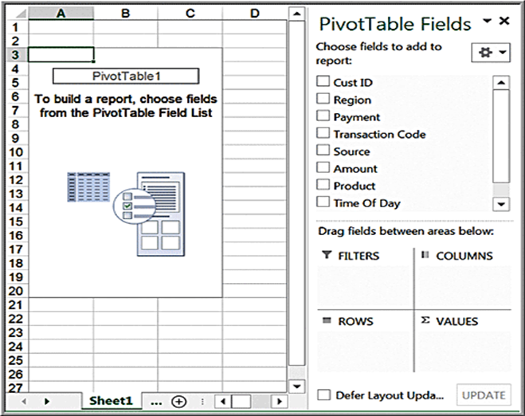
Example 2.21: Creating a PivotTable
Click inside the Sales Transactions database
The wizard creates a blank PivotTable as shown.

Slide 55
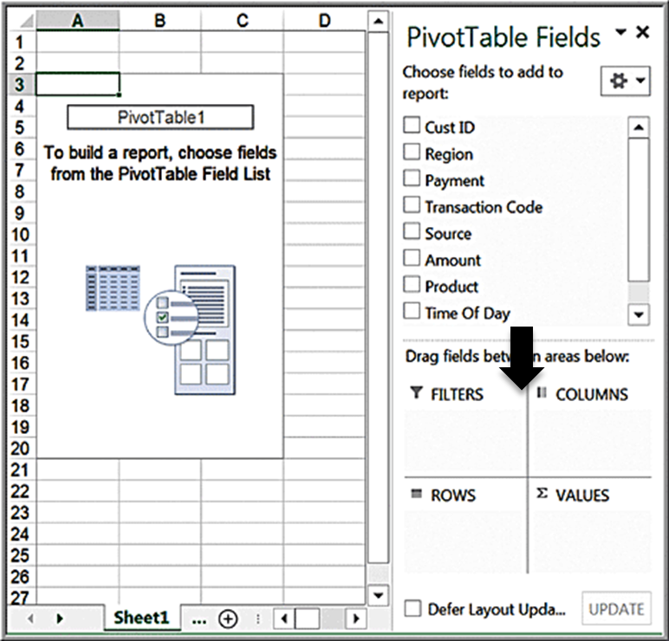

PivotTable Field List
Select and drag the fields to one of the PivotTable areas:
Report Filter
Column Labels
Row Labels
Values

Slide 56
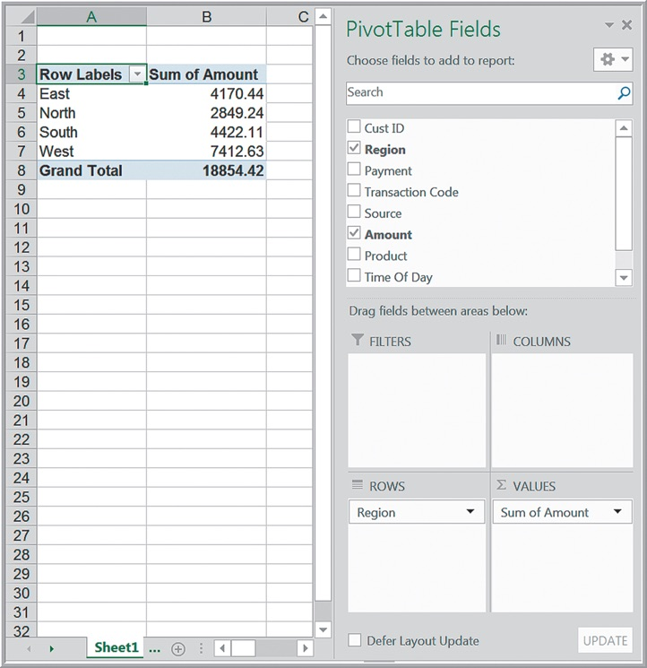
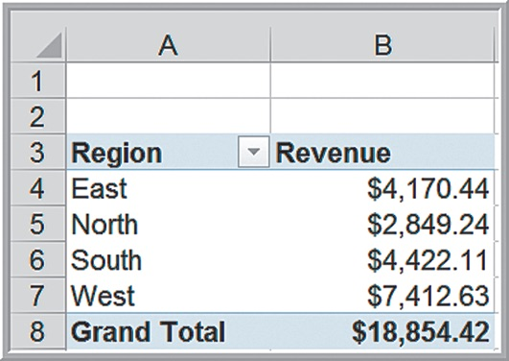
Pivot Table for Total Revenue by Region
You may select the range of the value, right click, and format the cells as currency to make the PivotTable more meaningful. You may also replace the names in the headers; for instance, change Row Labels to Region and Sum of Amount to Revenue.

Slide 57
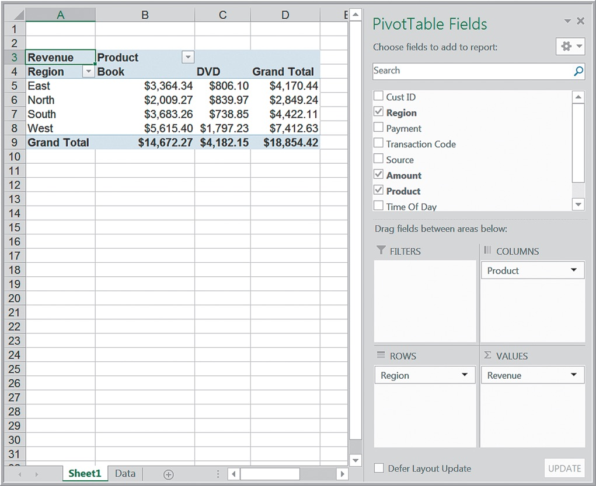
Revenue Breakdown by Region and Product

Slide 58
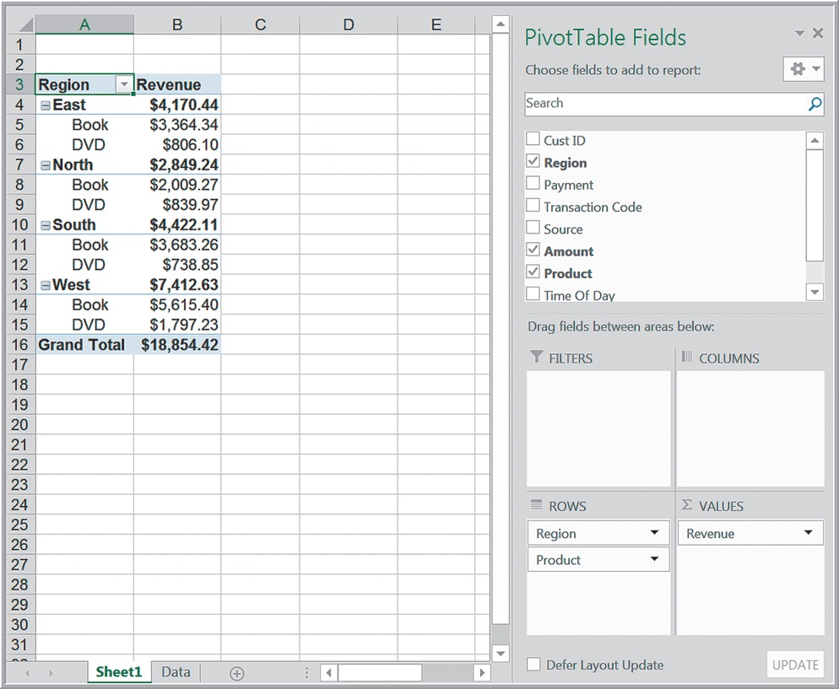
Alternate PivotTable View of Region and Product Revenue

Slide 59
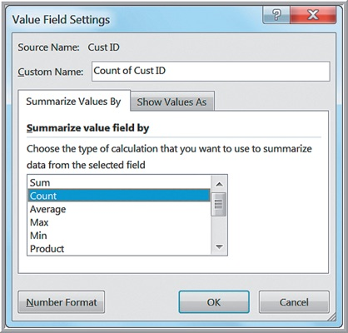

PivotTable Customization
When you drag a field into
Values area, the
PivotTable defaults to the sum of the values in that field. Click the dropdown arrow next to Revenue in
Values area and
choose Value Field Settings. Select Count.

Slide 60
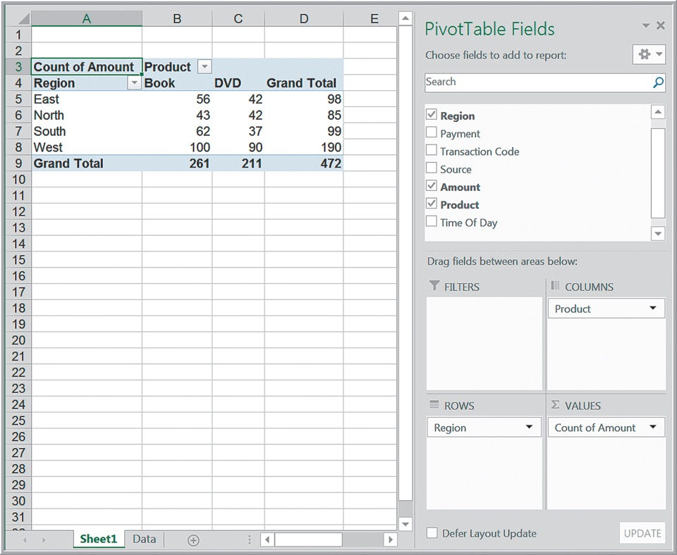
PivotTable for Count of Regional Sales by Product

Slide 61
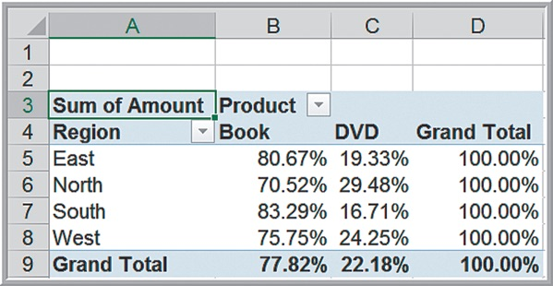
Percentage Views
Percent of the grand total, Percent of row total, Percent of column total, and other options
In the Value Field Settings dialog, click the tab Show Values As. Select the option in the dropdown box. The % of Row Total is shown:

Slide 62

Using the PivotTable Report Filter
Dragging a field into the Filters area in the PivotTable Field list allows you to add a third dimension to your analysis. Drag Payment to the Filters area. Click the drop down arrow in cell B1; choose Credit.

Slide 63
Slicers
Slicers are tools for drilling down to “slice” a PivotTable and display a subset of data.
To create a slicer for any of the columns in the database, click on the PivotTable and choose Insert Slicer from the Analyze tab in the PivotTable Tools ribbon in Windows, or from the PivotTable Analyze tab on a Mac.

Slide 64

Example 2.22: Using Slicers
For the PivotTable for the revenues by region and product, insert a slicer for the source of the transaction. If you click on one of the Source buttons, Email or Web, the PivotTable reflects only those records corresponding to that source.

